Slide 1
PQ Analysis
Frequency and Amplitude Estimation

Slide 2
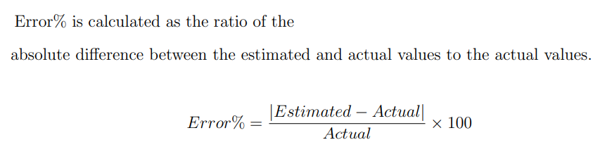

Slide 3
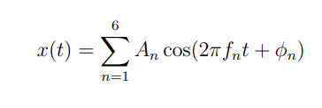
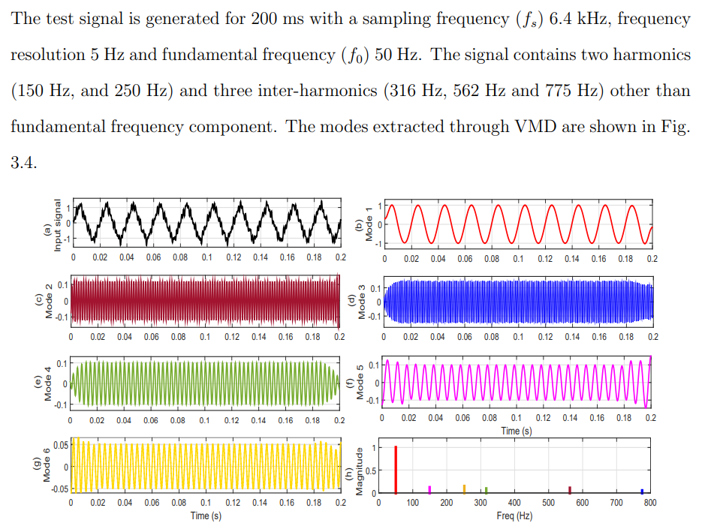
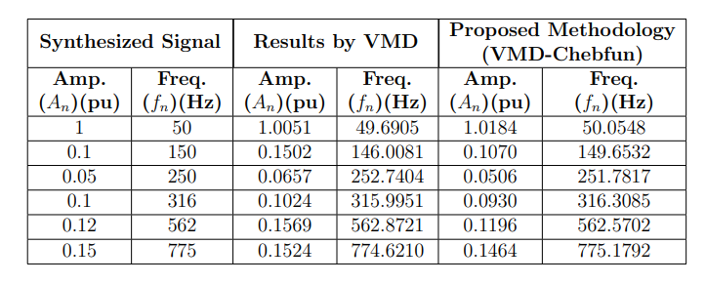
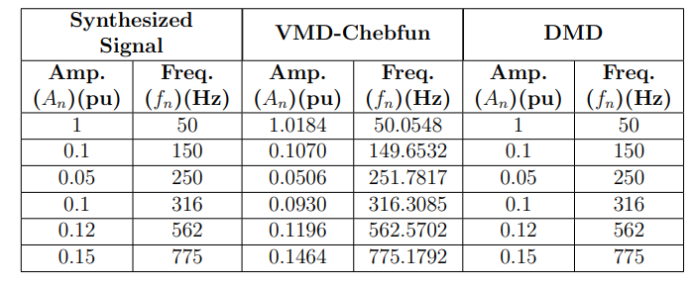
Case -1- detecting freq. & amp. of
Disturbance components

Slide 4
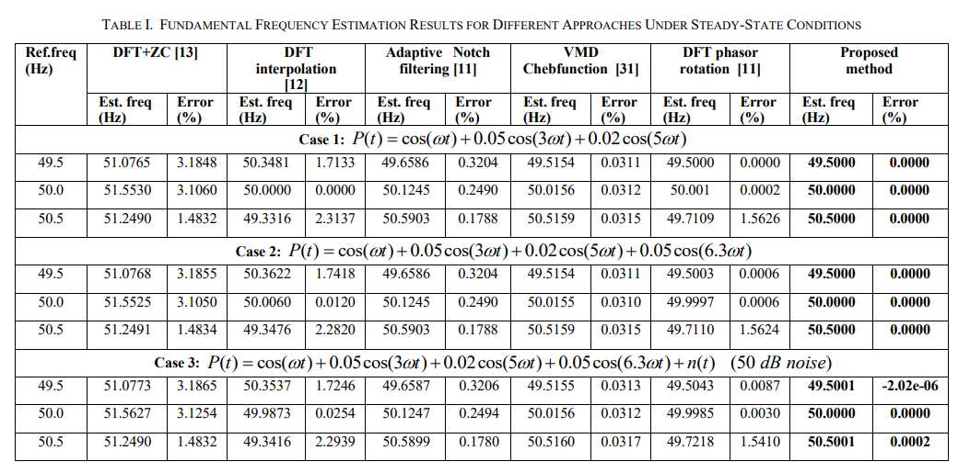
Case -2 -Fundamental frequency estimation
The test signal P(t) is synthesized for 1 second duration with a sampling frequency (fs) of 3.2 kHz.

Slide 5
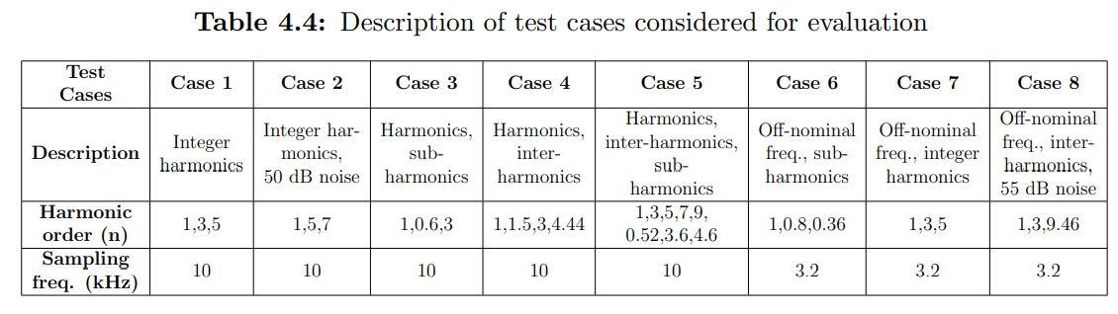
Case -3-Estimation of disturbance components
To confirm the performance advantage for the estimation of disturbance components, various test cases encountered in real power system scenarios are generated synthetically. This includes signals contaminated with noises, presence of harmonics, inter-harmonics and sub-harmonics, off-nominal frequency deviations etc. The description of the test cases considered for evaluation is depicted in Table 4.4 and all the test cases are generated for 200 ms duration.

Slide 6
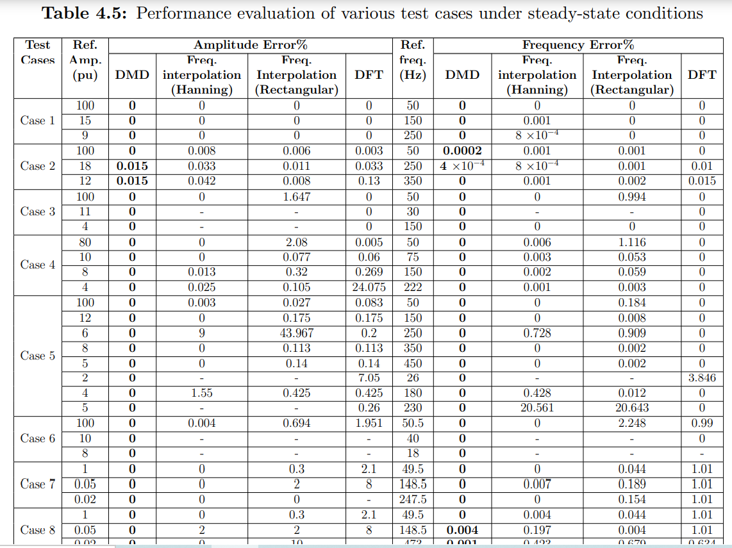

Slide 7
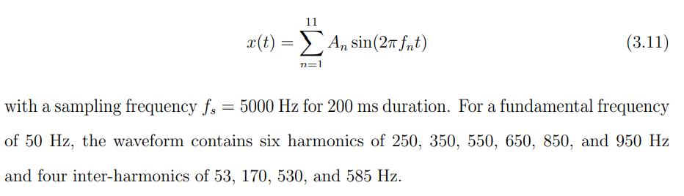
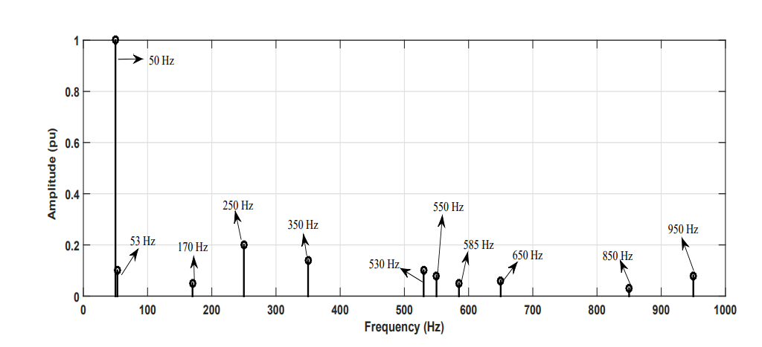
Case -4- Detection of inter-harmonics
Results of DMD
Also try this condition with fundamental
Frequency deviations such as 49.5 and 50.5 Hz

Slide 8
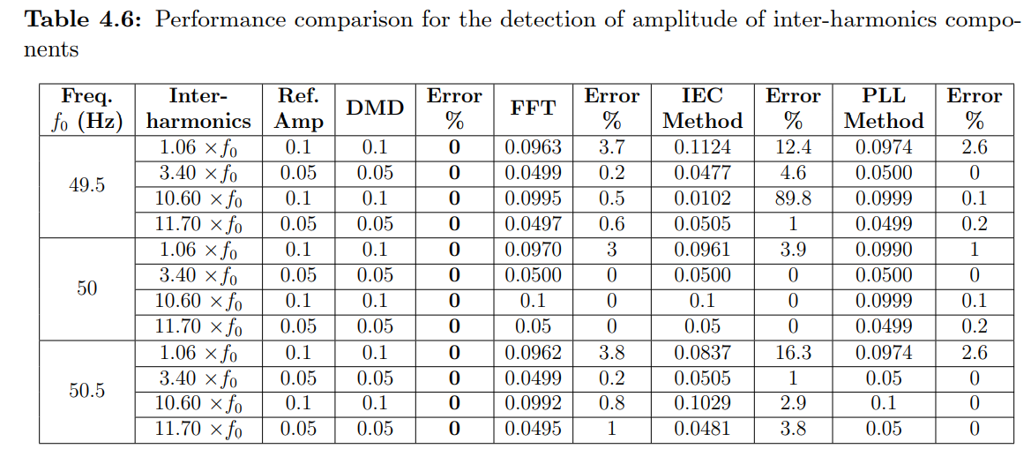
Case -5- Detection of amplitude of inter-harmonics
The analysis is carried out to determine the inter-harmonics for fundamental frequency deviations at 49.5 Hz, 50 Hz, 50.5 Hz and the results are given in Table 4.6. ((previous case) )

Slide 9
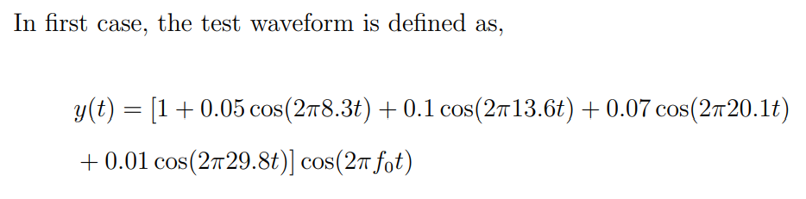
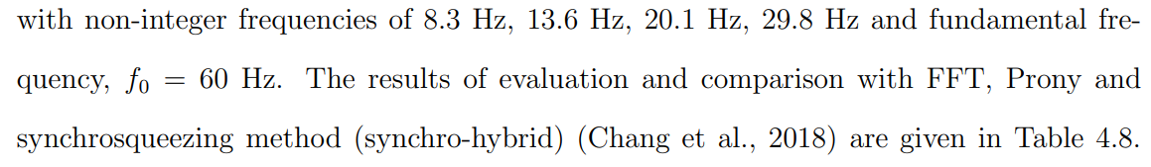
Case -6- Voltage Fluctuations
Voltage fluctuations are defined as random or systematic changes in the voltage envelope.

Slide 10
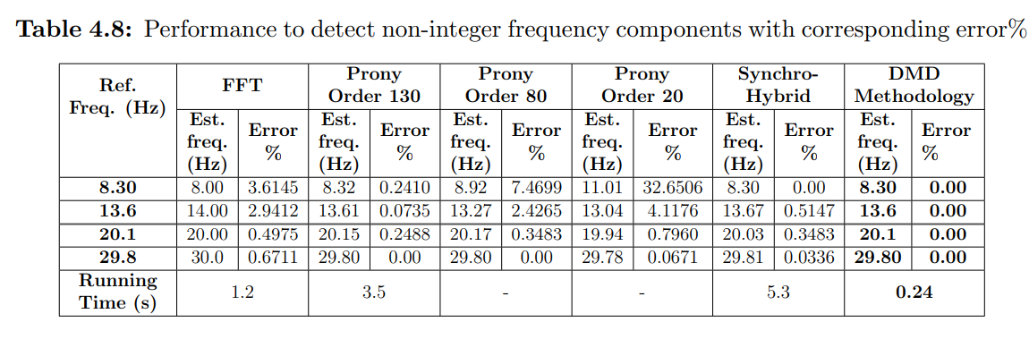

Slide 11
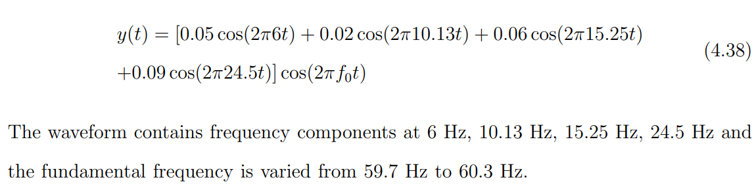
Case -7- Voltage Fluctuations with fun.freq. deviations

Slide 12
